Slide 1

HOTEL MANAGEMENT SYSTEM
Presented By:
Deepti Mhatre Axis10JFSB1015

Slide 2
INTRODUCTION
Hotel Management System is a web-based application that allows the hotel manager to handle all hotel activities online.
Interactive GUI and the ability to manage various rooms, employees and customers make this system very flexible and convenient.
This project provides room booking, staff management and other necessary hotel management features.

Slide 3
EXISTING SYSTEM
In the existing manual system a lot of time is spent in communicating the information across different branches. There is a need for an automated system, which has some centralized control over the entire process.
Conventional System makes use of huge amounts of paper for recording transactions. All the Hotel records are to be maintained for the details of each customer, Fee details, Room Allocation etc.
Disadvantages:
Time consuming
Inaccuracy of data

Slide 4
PROPOSED SYSTEM
Proposed system is the computerized version of the existing system which provides easy and quick access over the data. Keeping the records of registration of customer properly so that facilities provided by Hotels are fully utilized in effective and efficient manner.
Advantages:
Less Time consuming
Maintain accuracy

Slide 5
ADMINISTRATIVE MODULES
There are 2 modules in this project
Admin :
Admin can add a new room , a new employee.
Receptionist :
Receptionist can add a new customer and allocate rooms, can check all room details, customers details, employee details, search for a particular room etc.

Slide 6
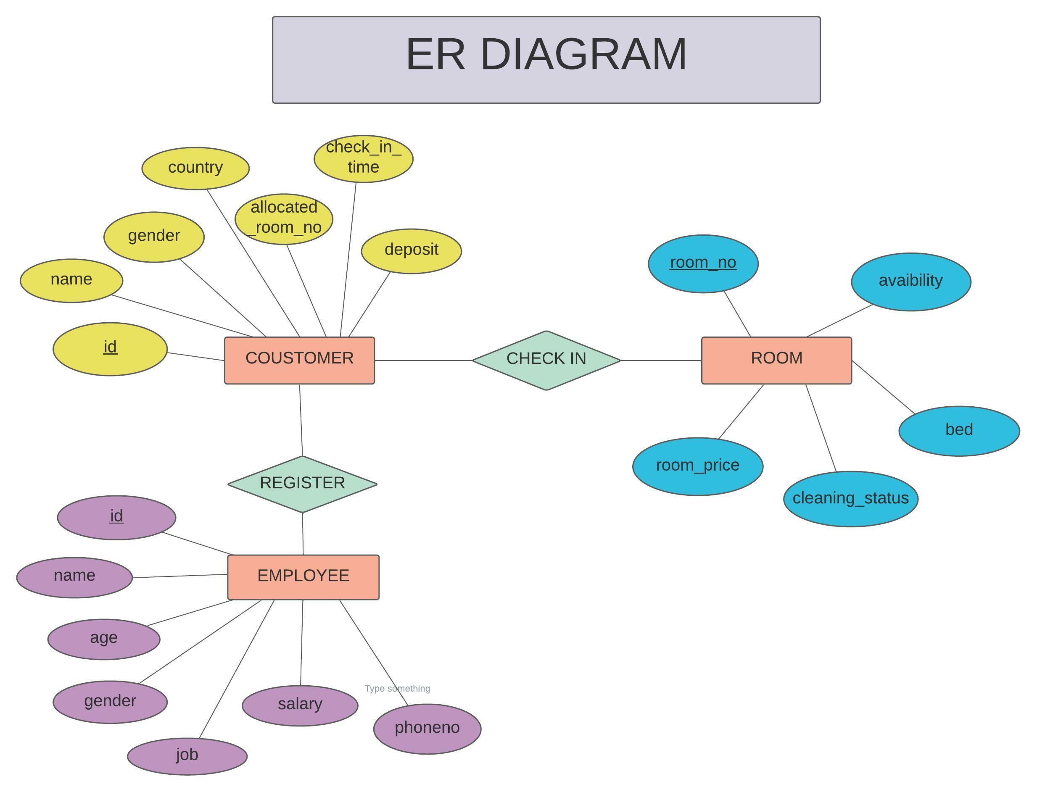

Slide 7
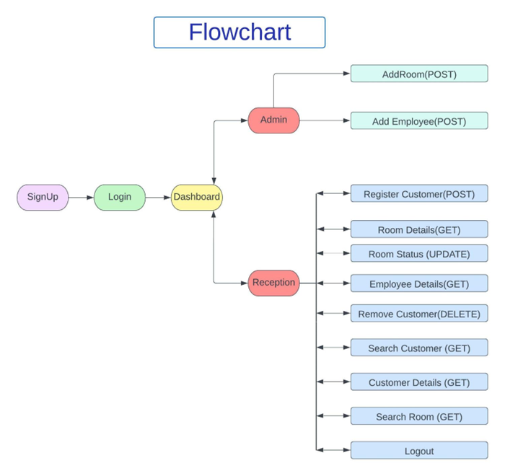

Slide 8







TOOLS USED

Slide 9
MICROSERVICES
Sr. No | Microservices | Port Number
1. | Customer Service | 8091
2. | Employee Service | 8092
3. | Room Service | 8093
4. | Login Service | 8094

Slide 10
Thank You

